Slide 1
How to write an essay
Literature exam - H4 2024

Slide 2
General information essay writing
It should be between 180-220 words.
You are not allowed to use/bring any extra information to class. We want to see your own English and the assignment will be clear, so you can write about that without extra information.
Your essay will be judged taking into account the following points:
- Content
- Language
- Conventions
- Use of grammar

Slide 3
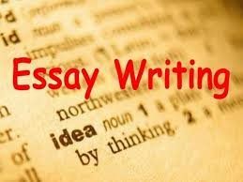
What to focus on
Think of an original title and write each word with a capital letter!
Don’t start your sentences with and, also, so, but, because
Skip a line after each paragraph (four paragraphs in total)
Please mind your punctuation, don’t use question and/or exclamation marks
MIND YOUR WORD ORDER!!!!
Don’t use any short forms → wasn’t = was not
Make sure your language setting (in Word) is on United Kingdom
Please open your Dutch-English dictionary below ‘invoegtoepassingen’ in Word
Be careful that your subjects agree with your verbs. (Use singular verbs for singular subjects and plurals for plurals: Jim thinks, but he and Judy think.)
Watch your spelling, capitalization (first word of each sentence, proper names like England and English, etc.), and punctuation.

Slide 4
What to study about your author?
Some personal information about your author (date/place of birth, nationality, education, etc.)
Which genre he/she particularly writes about
The content of at least one book (main points, no details)
Your opinion about your author

